Slide 1

Mobile Library Search
An Improvement.
Taylor Hickey Daniel Narmi
James Beavers Tomer Shvueli Danh Huynh

Slide 2
Introduction
What is our project?
Mobile Library Search for NCSU Library
Client: Mr. Cory Lown
What are our tasks?
Improve the mobile interface for searching the library's catalog to support "faceted" search, essentially menu-driven refined search.
Current state?
Several improvements have been successfully implemented
Some minor tweaks still left to complete at a later time

Slide 3
Initial version
Mobile UI in its infancy, so still somewhat plain
Maximum number of results
User unable to access more than 300 results at a time
Default maximum allowed in code
No option to refine the search
Many things could be improved

Slide 4
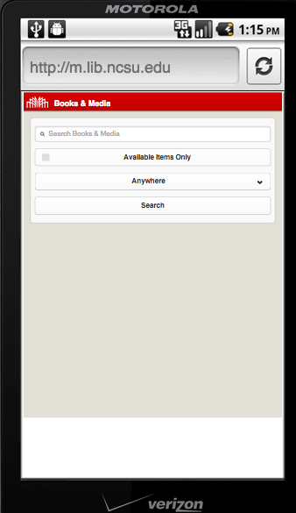
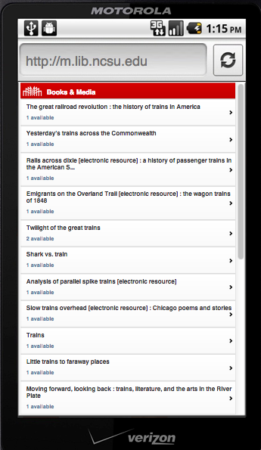
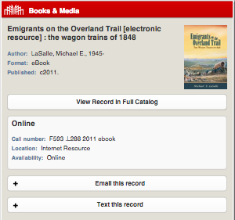
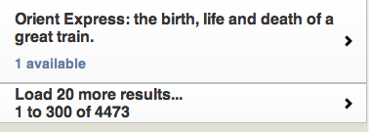
Initial Version
Some screenshots.

Slide 5
General Plans and Work:
What we initially decided to do?
Refine search option: Search filtering
Improve UI:
Transition and Endless Scrolling
Improve results display:
Preview box: display preview information for a given result

Slide 6
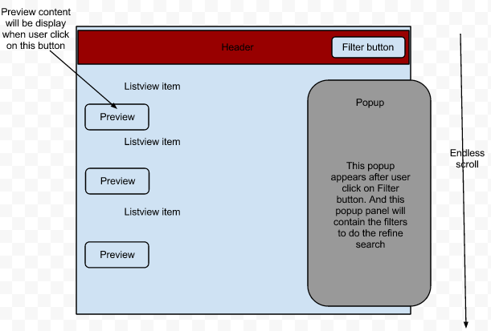
General Plans and Works
What we initially planned?

Slide 7
General Plans and Work:
What are the difficulties?
Lack of Experience: PHP, JQuery...
Time
Previous Feedbacks? From class and from client
back button, back to top button.
results listview layout.
filter search UI layout.
What we changed during implementing?
-No transition:
performance
conflicts with other features.
-Add other features..

Slide 8
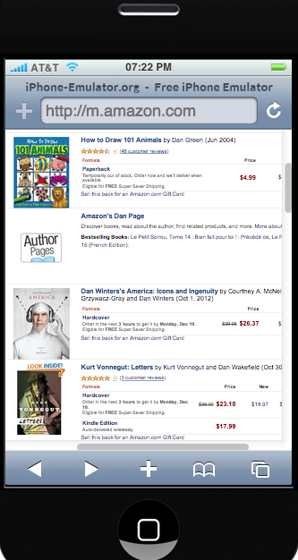
Improve Results Display
(Preview)
Decision: Choose different way to re-implement the layout of results listview.
=>Choose to display the preview content for each item of the list.
Web example: Amazon Books

Slide 9
Improve Results Display
(Preview)
Comparing 2 Version:
LIVE DEMO

Slide 10
Refine Search
What we did?
Added filter option on the header
Created a popup panel for search filtering
Added the option to refine the current search by filter options such as:
subject, genre, call number location, library, author, region
Added option to remove current filters

Slide 11
Refine Search
What else could be improved?
Display only a few of the sub-filter options while giving the option to expand the list further
Optimize choice of provided filter list. There are eleven filters possible, we provided six to avoid clutter
Others?

Slide 12
Refine Search
LIVE DEMO

Slide 13
Infinite Scroll
What we did?
Modify code to load the results by page
Can get all the results of a search vs 300 limitation.
Get a status bar at footer for results counting.
Using AJAX infinite scroll:
Load more at scroll to the bottom page
Alternative link to go to the next page.

Slide 14
Infinite Scroll
Compare 2 Versions:
LIVE DEMO

Slide 15
Other improvements.
Back button in detail page.
Start over the search
Back to top button to support infinite scroll
Search within content

Slide 16
Other Improvements
LIVE DEMO

Slide 17
Other improvements.
What else could be improved?
Improve search within content:
On-the-fly search within results.
What else?

Slide 18
Testing
All features working on:
Android 4.04: Chrome, default Web browser.
iOS 6.1: Safari
PC: Chrome, Safari
Refine search works on most of the devices/browsers.
Some features not working on some devices/browsers:
Search within content not working on PC Firefox browser
Scrolling feature not working on some old smartphones : Palm...

Slide 19
What we learned?
Another Team Project: solving problem when working in team.
Experiencing new techniques:
PHP, AJAX, JQuery...
There are things to be improved: features, UI, compatibility...

Slide 20
Feedbacks?
Please comment on our product.
Thank you.

